Slide 1
Oliver Twist
Mohammadreza Badpa
Liberal Arts @ Progress School
May 20, 2021

Slide 2
Topics
01. Introduction
02. Charles Dickens
What on earth’s Oliver twist? What kind of person would call a book “Oliver Twist”? This is Bizarre.
Apparently he’s a famous guy! I didn’t know him, until I one of his books!
Also, his last name is unappropriated but I’m just going to leave it as it is.
03. More Details
04. My Opinion On it
05. References
More details about the book. I don’t know what you want for me. tbh I just started reading the book yesterday.
My Opinion on this book! Yes, I did just start reading it yesterday but It doesn’t mean I don’t have an Opinion!
The Links of the websites I used for the Information on this presentation, nothing exciting!

Slide 3

Introduction
Oliver Twist is Charles Dickens's second novel, and was published as a serial from 1837 to 1839 and released as a three-volume book in 1838, before the serialization ended. The story centers on orphan Oliver Twist, born in a workhouse and sold into apprenticeship with an undertaker. After escaping, Oliver travels to London, where he meets the "Artful Dodger", a member of a gang of juvenile pickpockets led by the elderly criminal Fagin.

Slide 4
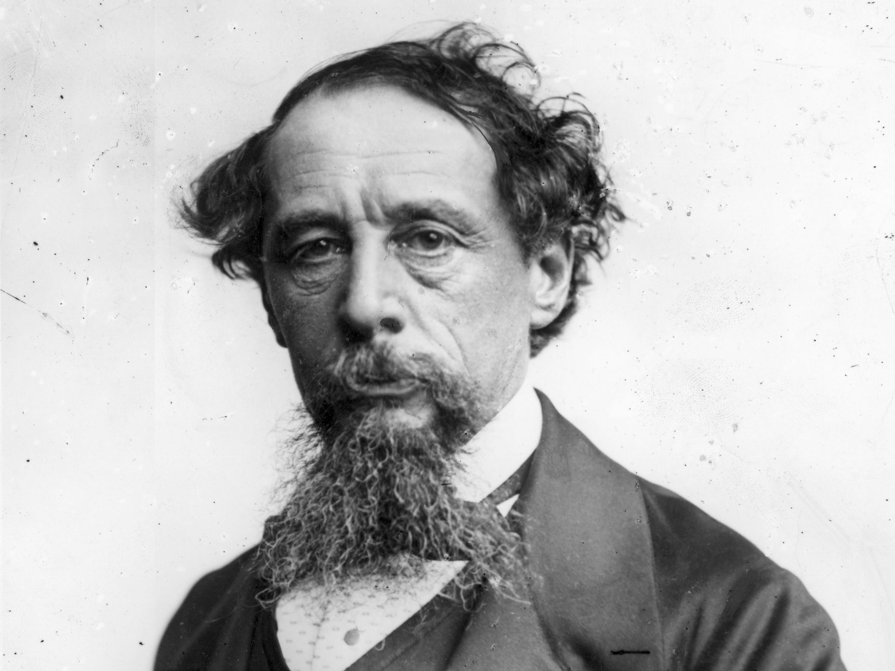
Charles Dickens
Charles John Huffam Dickens FRSA was an English writer and social critic. He created some of the world's best-known fictional characters and is regarded by many as the greatest novelist of the Victorian era.

Slide 5
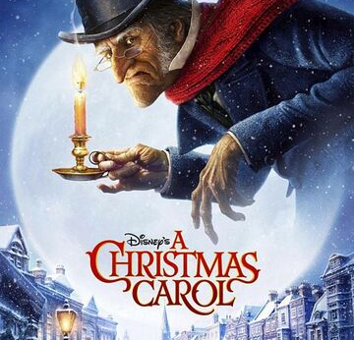
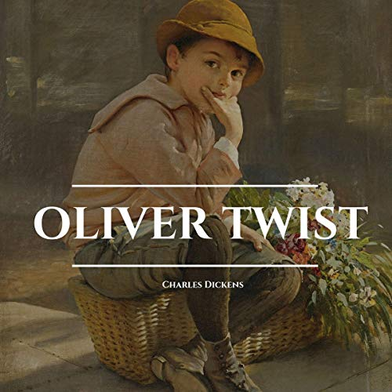
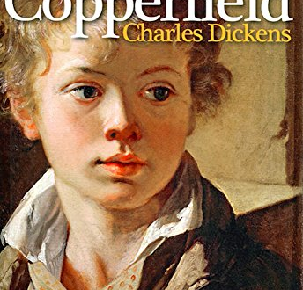

Known Books
Christmas Carol
Oliver Twist
David Copperfield
Bleak House
1843
1838
1849
1852

Slide 6
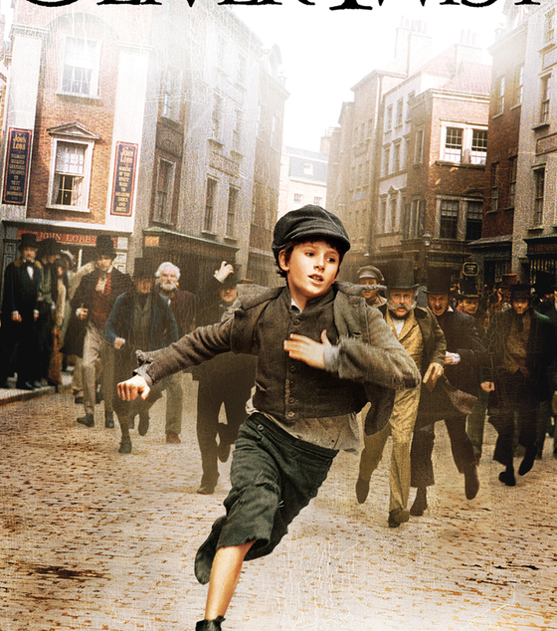
More Details
The novel follows the journey of the titular character, Oliver Twist. Oliver, an orphan since birth, spends much of his childhood at a “child farm” (orphanage) with too many children and too little food. The farm is located roughly 70 miles outside London. After escaping the farm, we goes through a journey to survive in the wild world.
Depending on the Level, the book can be from 80-1000 pages long.

Slide 7
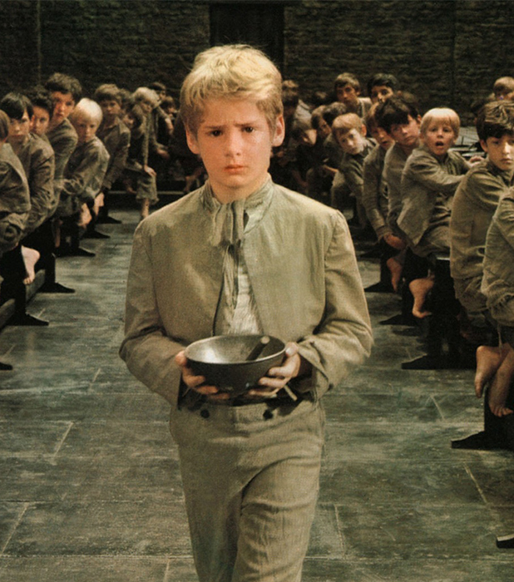
Opinion
Oliver Twist was quiet an Interesting Novel. It has a unique type of story, unlike the other one’s that I’ve read.
To be frank, the reason why I might think this book was unique is probably because I haven’t read that many Novels in my life.
After all, this book was a unique one. I’m not saying I love it, it’s just that I’m alright with it. It’s not my favorite type of Novel but that might be because I don’t normally read books.

Slide 8
Reference
Wikipedia
Microsoft
Me
A Big Thanks to Wikipedia for Charles Dickens & Oliver Twist Pages.
Thanks to Microsoft for Letting Me Use their “Microsoft Office” for this Project.
The Biggest Thanks to me.

Slide 9
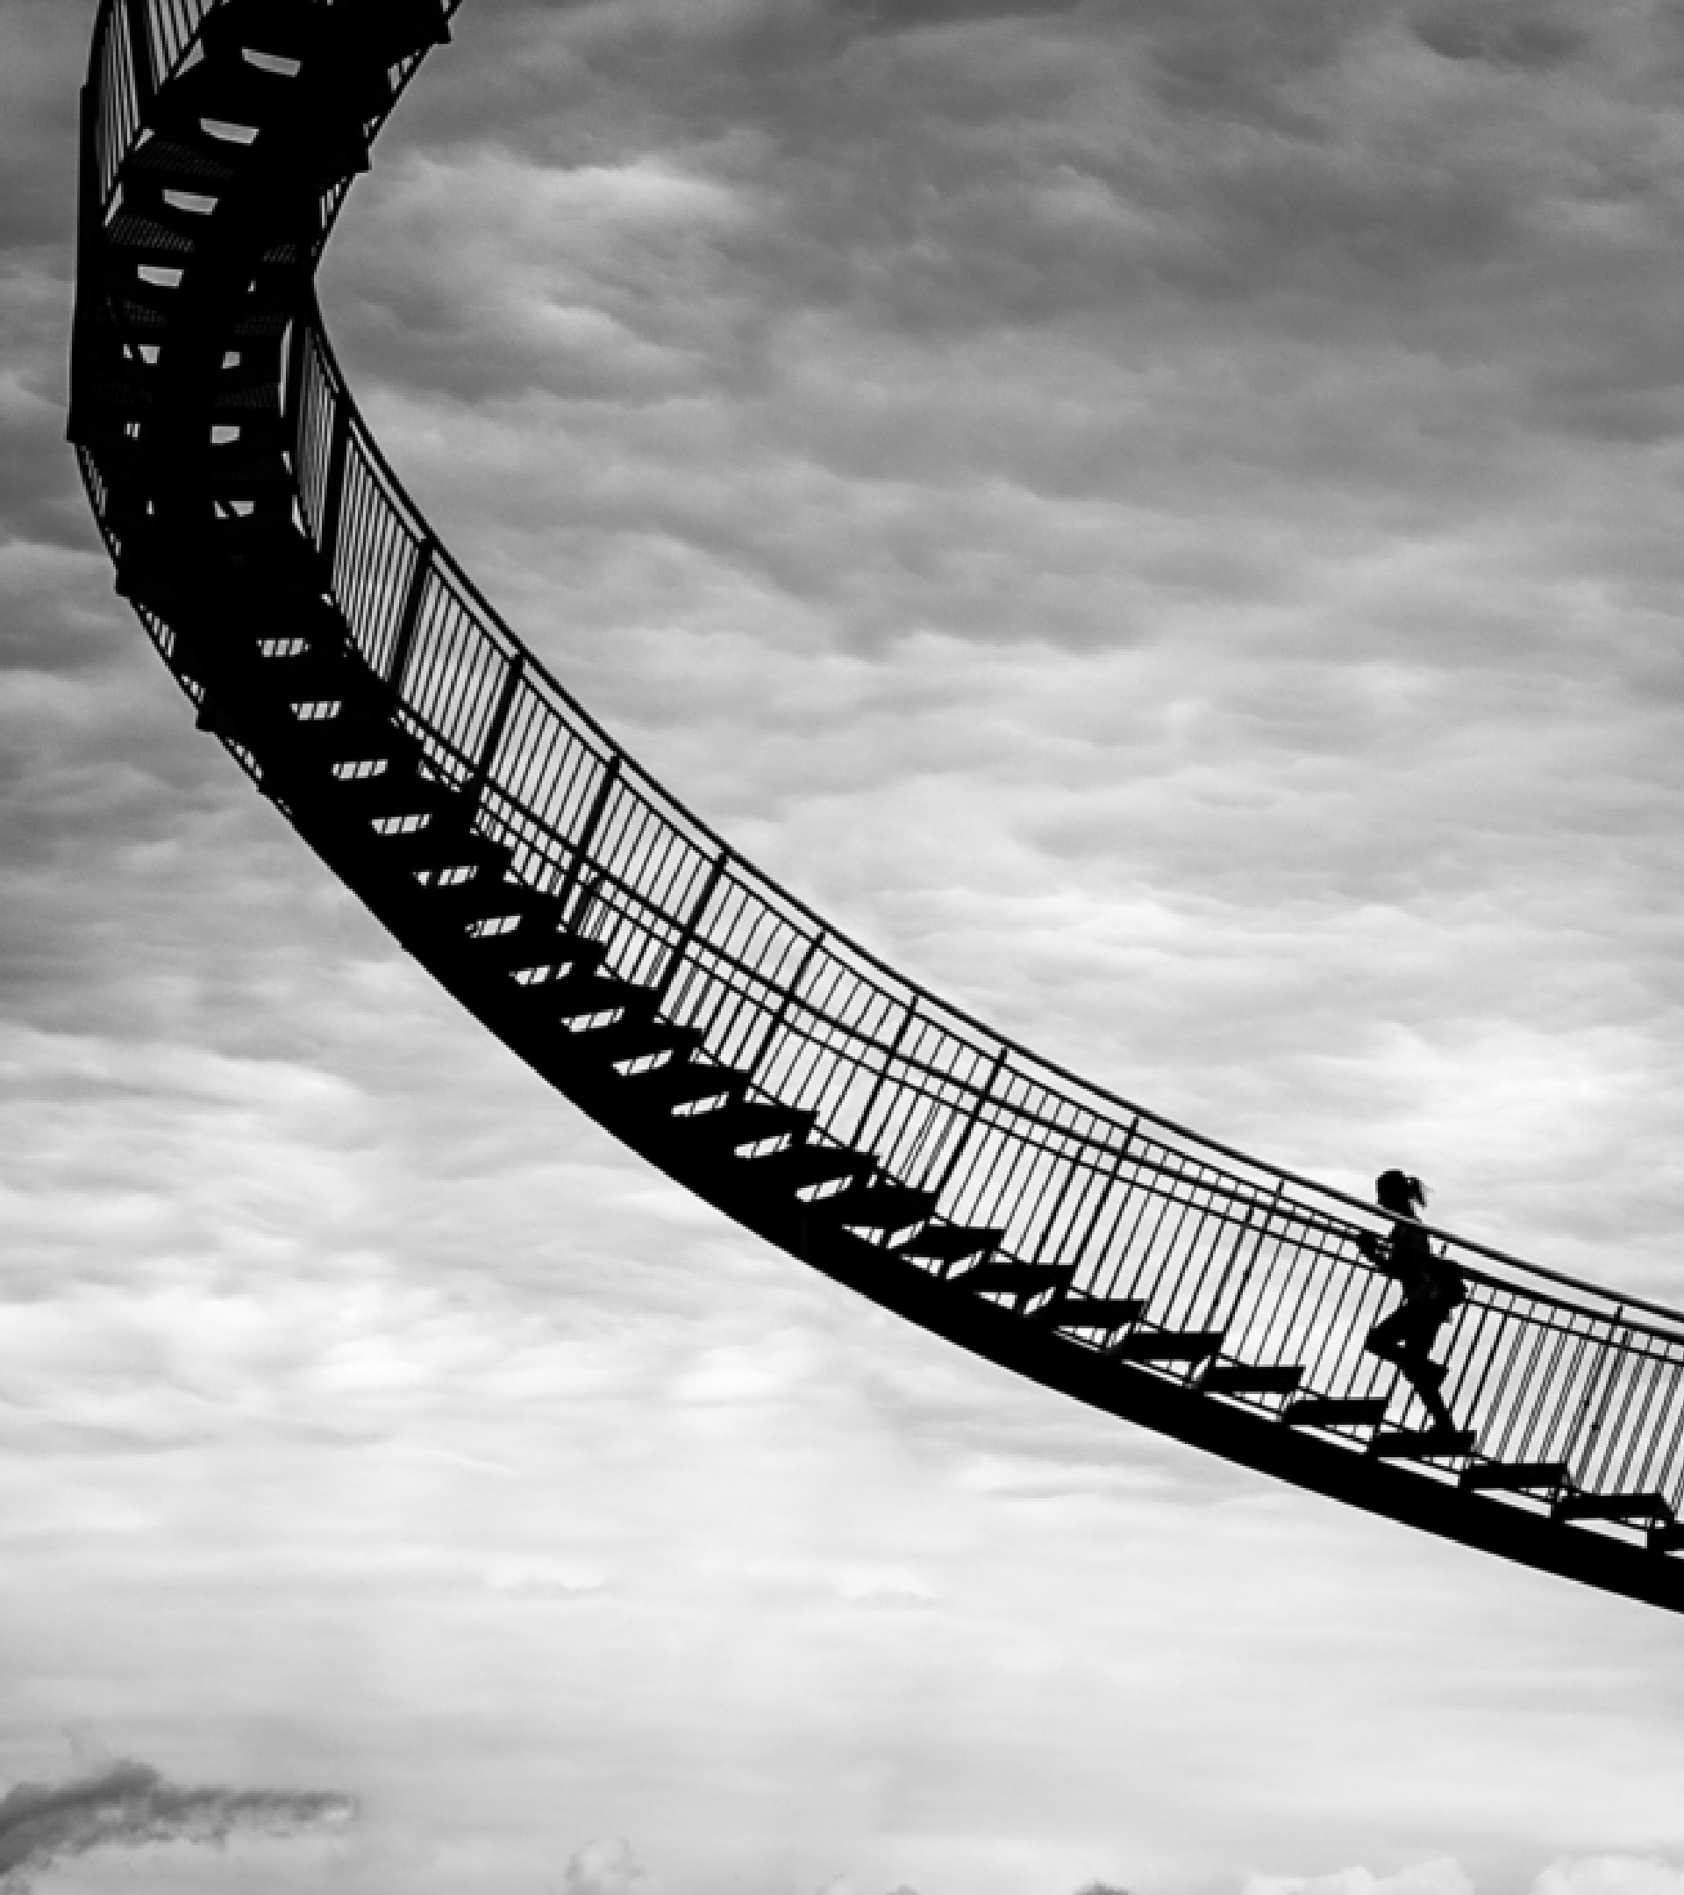
Thanks For Listening
Thanks to Everyone listening to this presentation. This is a box that I’m filling just because I can, even though I don’t know what to write in it!
Mohammadreza Badpa
LiberalArts@ProgressSchool.Earth

